Slide 1

Machine Learning Engineer
Monolisa p
date:06/10/2025

Slide 2


Workflow ||
Data Collection |
Data Preprocessing (cleaning, scaling, feature engineering) |
Model Selection & Training |
Evaluation (accuracy, precision, recall, etc.) |
Deployment & Monitoring
Machine Learning
Machine Learning (ML) is a branch of Artificial Intelligence (AI) that allows computers to learn from data and improve their performance without being explicitly programmed. Instead of following fixed rules, ML systems find patterns, make predictions, and take decisions by analyzing past experiences (data).
Future of ML
Integration with AI & IoT
Generative AI (like ChatGPT, DALL·E)
More focus on Explainable AI (XAI)
Industry adoption across healthcare, finance, transport, education
Machine Learning = Data + Algorithms → Patterns → Predictions/Decisions

Slide 3

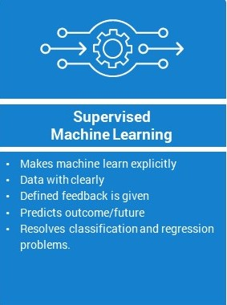
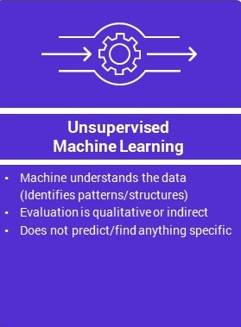
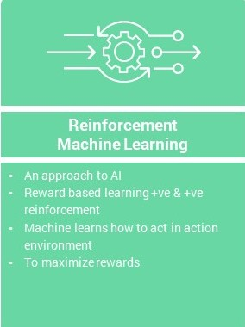
Machine Learning fundamentals
Machine Learning (ML) fundamentals are the core principles and basic approaches that explain how machines can learn patterns from data and improve performance without being explicitly programmed.
Machine Learning types

Slide 4

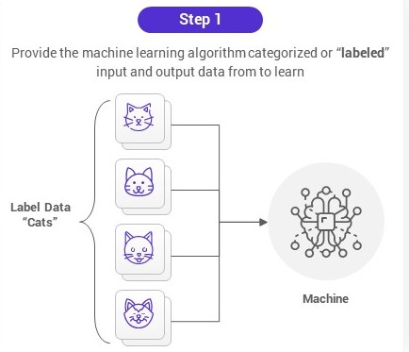
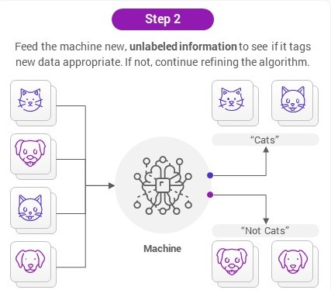
supervised learning
Trains a model using labeled data, where both inputs and correct outputs are known. It then uses this learning to predict outcomes for new, unseen data.
How it works??

Slide 5
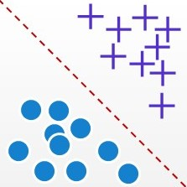
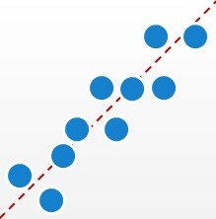
Supervised Learning algorithm types
Classification algorithm
Regression algorithm
Goal is to predict categories or classes from input data
Goal is to predict continuous numeric values from input data
Types of classification algorithms
Types of Regression algorithms
Logistic Regression Naïve Bayes Stochastic Gradient Descent K-Nearest Neighbours Decision Tree Random Forest Support Vector Machine
Linear Regression Non-Linear Regression Logistic Regression Ridge Regression Lasso Regression Polynomial Regression Bayesian Linear Regression

Slide 6
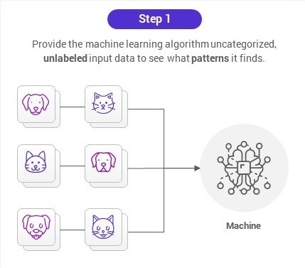
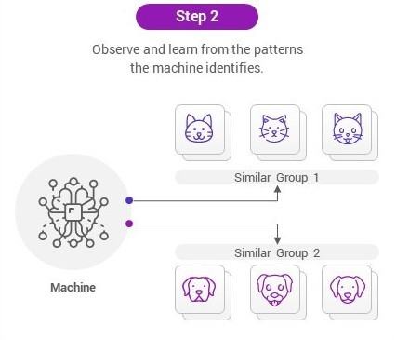
unsupervised learning
The goal is to find hidden patterns, structures, or relationships in the data without predefined output labels.
How it works??

Slide 7
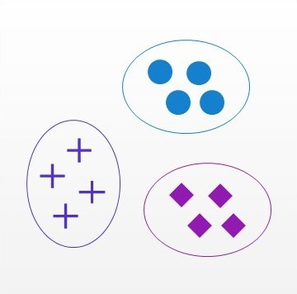
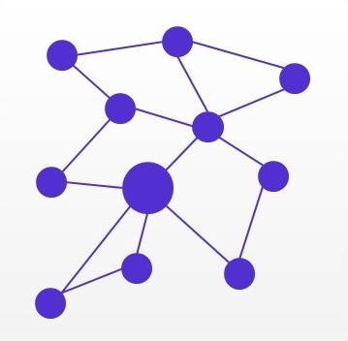
unsupervised Learning algorithm types
Clustering algorithm
association algorithm
groups similar data points into clusters such that items in the same cluster are more similar to each other than to those in other cluster
finds relationships or co-occurrences among variables in large datasets.
Types of clustering algorithms
Types of association algorithms
Hierarchical clustering K-means clustering K-NN (k nearest neighbours) Principal Component Analysis Singular Value Decomposition Independent Component Analysis
Apriori Eclat FP Growth Algorithm

Slide 8
reinforcement learning
Reinforcement Learning is a type of machine learning where an agent learns by interacting with an environment. The agent takes actions, receives rewards/penalties, and improves its strategy (policy) to maximize cumulative reward.
Key Terms in Reinforcement Learning
Agent An entity that can perceive or explore the environment and act upon it.
Environment The situation or world in which the agent exists. 👉 In RL, the environment is often stochastic (random in nature).
Action The possible moves or decisions taken by the agent within the environment.
State The condition or situation returned by the environment after each action taken by the agent.
Reward The feedback given to the agent by the environment, used to evaluate the action.
👉 Positive reward = good action; Negative reward = bad action.
Policy A strategy or rule that the agent follows to decide the next action based on the current state.
Value The expected long-term return (future rewards) with a discount factor, unlike reward which is short-term.
Q-Value (Action-Value) Similar to the value function but considers the current state + chosen action as parameters.

Slide 9
Data preprocessing
Feature engineering
Data cleaning
scaling
Creates or modifies features for better learning.
Includes extraction, transformation, combination.
Improves model accuracy and interpretability.
Example: From DOB → Age = 2025 – 1998 = 27.
Brings data into a common range/scale.
Prevents dominance of large values.
Two types: Normalization & Standardization.
Example: Marks 85/100 → 0.85 (normalized).
Removes duplicates, noise, and errors.
Handles missing values with mean/median/mode.
Ensures data consistency.
Example: Fill missing salary with average ₹50,000.
Raw data
Data cleaning
Feature engineering
scaling
Ready for ml

Slide 10
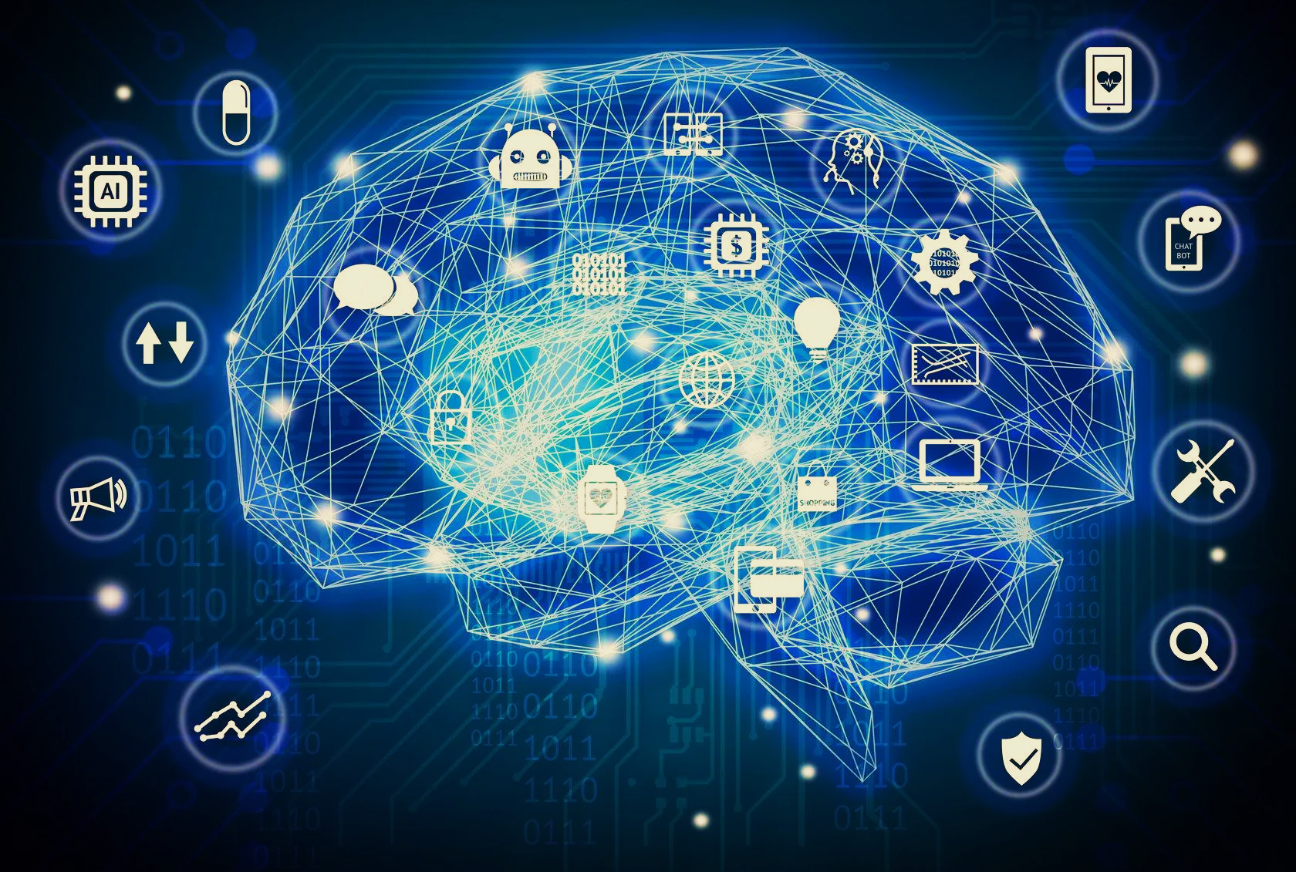
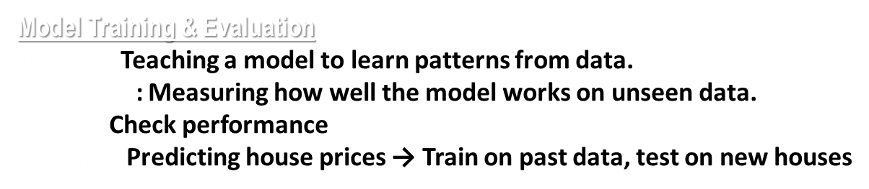
Model development
Evaluation Metrics
Accuracy | % of correct predictions | 80/100 emails correct → 80%
Precision | Correct positive predictions / Total predicted positives | Predicted 50 spam, 45 correct → 90%
Recall | Correct positive predictions / Total actual positives | 45/60 actual spam → 75%
F1 Score | Harmonic mean of Precision & Recall | Precision 90%, Recall 75% → F1 ≈ 0.82

Slide 11
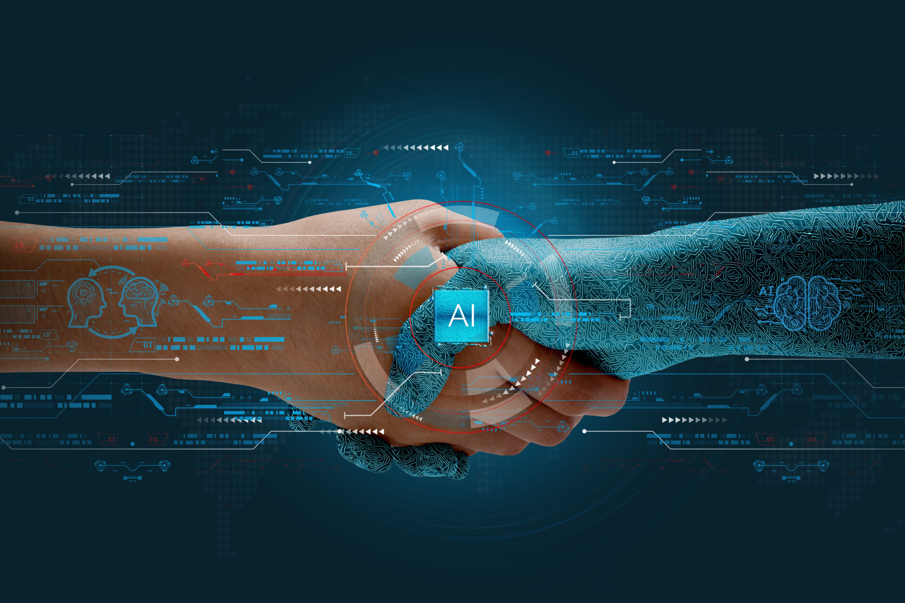


LLMs & generative AI
An AI model trained on massive amounts of text to understand, generate, and manipulate human language.
It predicts and generates text based on the patterns it learned.
Example:
GPT-4: Can write essays, answer questions, summarize text , etc.
LLaMA (Meta): Research-focused, efficient for smaller-scale applications.
Usage: Chatbots, email assistants, text summarizers, code generators.
AI that can create new content (text, images, audio, code) instead of just analyzing data.
It creates rather than just predicts or classifies.
Example:
Text: ChatGPT writing a story.
Images: DALL·E generating artwork from prompts.
Audio: AI composing music or voices.
Code: Copilot suggesting code while you type.
Usage: Content creation, design, coding, music, video generation.

Slide 12

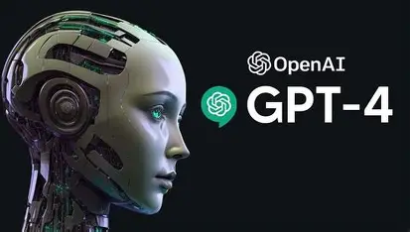
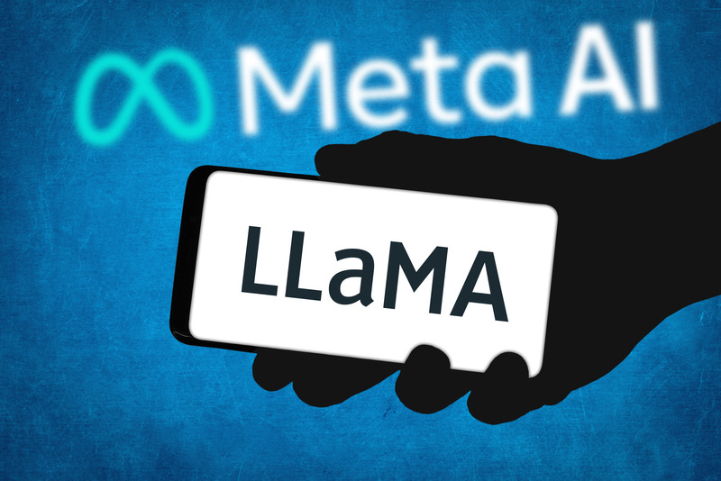

LLMs & generative AI
GPT (OpenAI) – Understands & generates text, answers questions, writes code. Example: ChatGPT, email/story writing, code generation.
LLa MA (Meta) – Research-focused, efficient text tasks. Example: NLP research, translation, summarization.
Mistral – High-performance, open-weight model for research & dev. Example: Open-source AI experiments, custom apps.

Slide 13

1. ML Pipeline Architecture
ML pipelines define the end-to-end flow from raw data to predictions.
Stages:
Data Collection & Ingestion – Gather raw data from DBs, logs, APIs
Data Preprocessing – Cleaning, handling missing values, normalization
Feature Engineering – Creating or transforming features for better model performance
Model Training – Train ML models using processed data
Model Validation & Evaluation – Check performance with metrics (accuracy, F1, precision, recall)
Model Registry – Store versioned models for deployment
Deployment / Serving – Make model available via API or batch predictions
Monitoring & Feedback – Track model drift, errors, retrain when needed
System design for ml
2.Serving API
Exposes ML model via API for real-time or batch predictions. Client → API Server → Model → Prediction → Client
Types:
Real-time: Instant results (fraud detection, recommendations)
Batch: Periodic predictions (sales forecast)
Tools:
Flask, FastAPI, Django REST
TensorFlow Serving, TorchServe, BentoML
Docker, Kubernetes, AWS SageMaker
Example: E-commerce → API → Model → Recommend products
Data Collection →Data Preprocessing → Feature Engineering→ Training → Evaluation→ Deployment→ Monitoring

Slide 14


Containers & deployment
ML Model
Container :
A lightweight package with ML model, code, and dependencies.
Ensures consistency & portability across environments.
Tool: Docker
Deployment :
Process of making ML models available for predictions (API, apps, batch).
1. Dockerizing ML Models
Wrap model + dependencies in a Docker container.
Why: Portable, scalable, easy to manage.
Example: Fraud detection model in Docker, deployed on Kubernetes.
2. Serverless Inference
Run models without managing servers (cloud executes on demand).
Why: Cost-efficient, auto-scaling, pay per request.
Tools: AWS Lambda, Google Cloud Functions, Azure Functions.
Example: Image classification triggered by file upload in cloud storage.
Container
Deployment
Prediction Output

Slide 15

Monitoring & mlops
Practices to track, manage, and improve ML models in production.
Ensures models remain accurate, reliable, and scalable.
1. Model Drift Detection
What: Identifying when a model’s performance declines due to data changes.
Why: Data in real world evolves → model predictions degrade.
Types:
Data Drift: Input data distribution changes.
Concept Drift: Relationship between input & output changes.
Example: Spam filter accuracy drops as new spam patterns appear.
2. A/B Testing
What: Comparing two or more model versions in production.
Why: Test improvements before full rollout.
How: Split users into groups → Group A sees old model, Group B sees new model → compare performance.
Example: Recommender system tests new ranking model on 10% of users.

Slide 16

SECURITY→PROTECTING DATA AND PII INML PIPELINES
Definition:
Protects data, models, and PII from unauthorized access or breaches.
Example:
Hospital predicting patient readmission: encrypt data, mask names/IDs, serve via secure API.
Types:
Data-level: Encryption, anonymization/pseudonymization
Model-level: Version control, integrity checks
API/Infra-level: Secure APIs, RBAC, audit logs
Why:
Prevents data breaches & model tampering
Ensures compliance (GDPR, HIPAA)
Maintains user trust
Where (in ML pipeline):
Data ingestion: Encrypt & mask PII
Preprocessing: Anonymize identifiers
Training/Validation: Secure storage & access
Deployment/API: Authenticate users, prevent leaks
Monitoring: Audit logs, detect anomalies

Slide 17


